Slide 1

Deep Neural Network Module # 6: CNN
DNN Team
BITS Pilani WILP

Slide 2
The instructor is gratefully acknowledging the authors who made their course materials freely available online.
This deck is prepared by Seetha Parameswaran.
Deep Neural Network

Slide 3










Table of Contents
Computer Vision Tasks
Image Basics and Image Classification Challenges
Introduction to Convolutional Networks
CNN Components
CNN Architecture Design
Popular CNN Architectures
Transfer Learning
CNN Applications
Implementation Considerations
Summary
1
2
3
4
5
6
7
8
9
10
Deep Neural Network

Slide 4
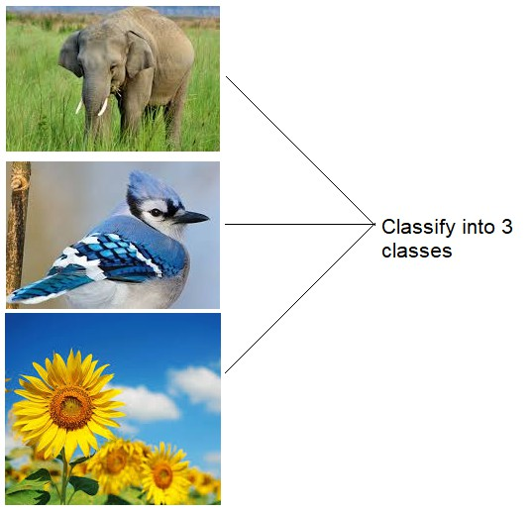
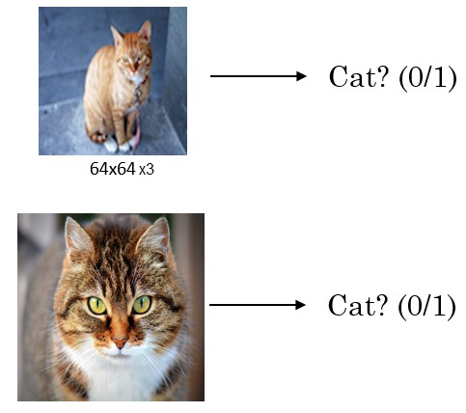
Image Classification
Deep Neural Network

Slide 5
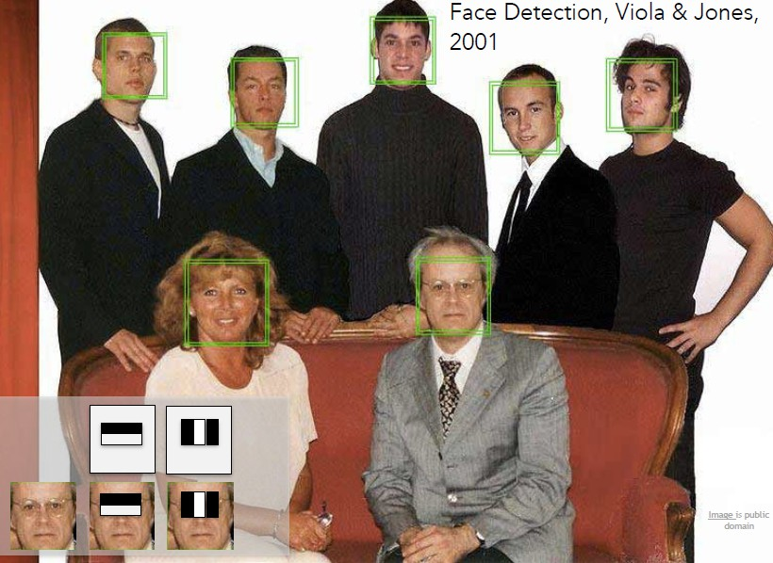
Face Detection
Fei-Fei Li & Justin Johnson & Serena Yeung
Deep Neural Network

Slide 6
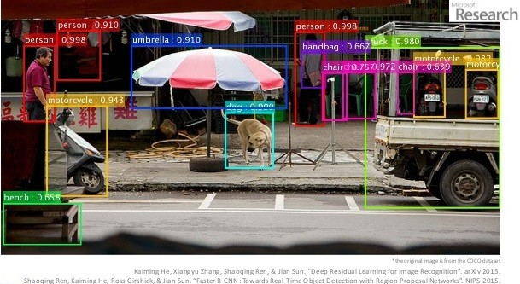
Object Recognition
Derin-Renme-Nedir-Akademik-Biliim-2016
Deep Neural Network

Slide 7
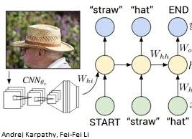
Image Captioning
Deep Neural Network

Slide 8


Table of Contents
Computer Vision Tasks
Image Basics and Image Classification Challenges
Introduction to Convolutional Networks
CNN Components
CNN Architecture Design
Popular CNN Architectures
Transfer Learning
CNN Applications
Implementation Considerations
Summary
1
2
3
4
5
6
7
8
9
10
Deep Neural Network

Slide 9
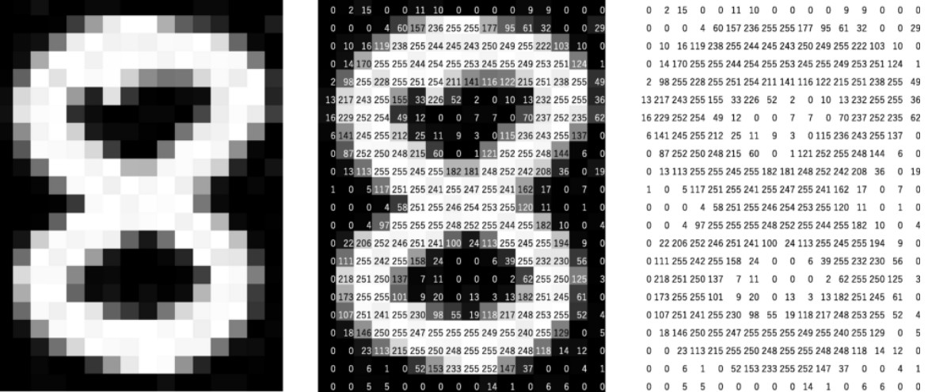
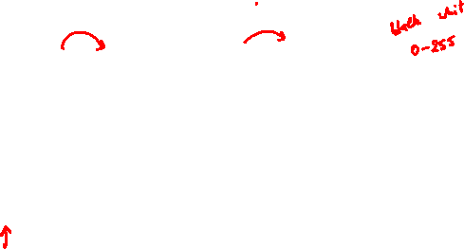
Digital Grayscale Image
Pixel intensities = I(x , y )
https://mozanunal.com/2019/11/img2sh/
Deep Neural Network

Slide 10
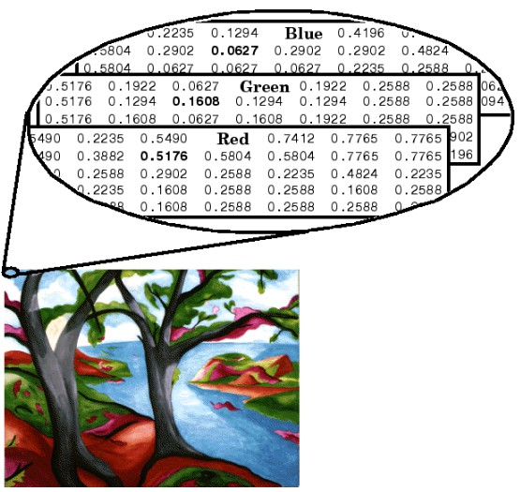
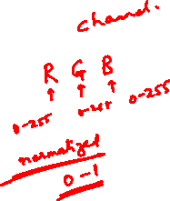
Digital Color Image
https://www.mathworks.com/help/matlab/creating_plots/image-types.html
Deep Neural Network

Slide 11
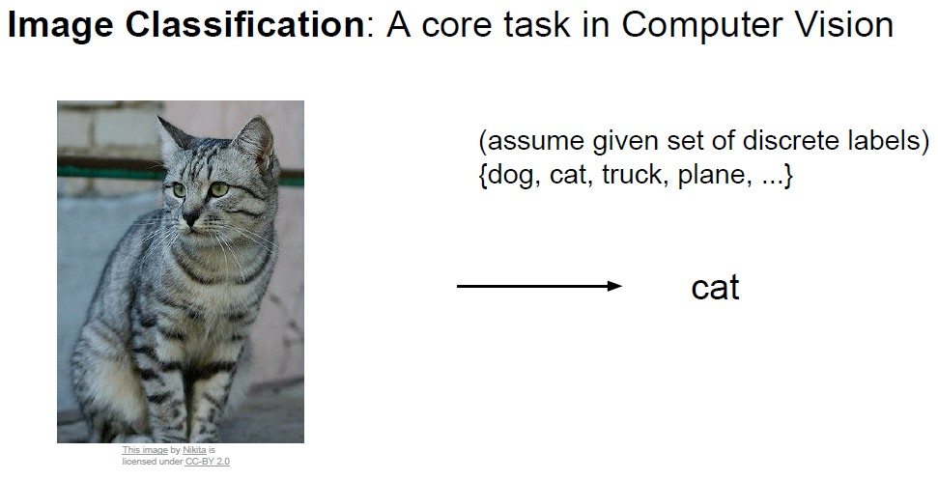
Image Classification - Challenges
Fei-Fei Li & Justin Johnson & Serena Yeung
Deep Neural Network

Slide 12
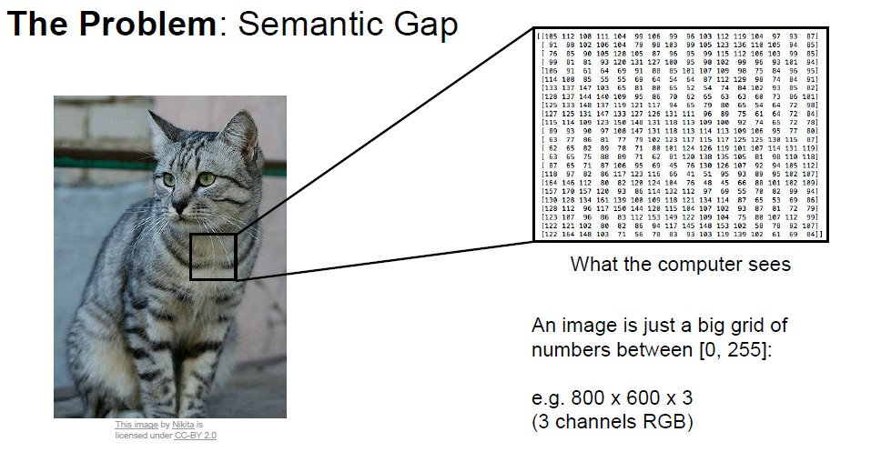
Image Classification - Challenges
Fei-Fei Li & Justin Johnson & Serena Yeung
Deep Neural Network

Slide 13
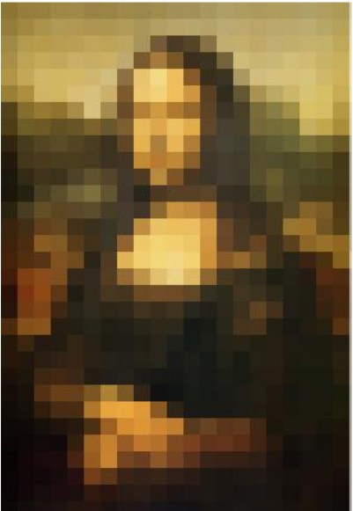
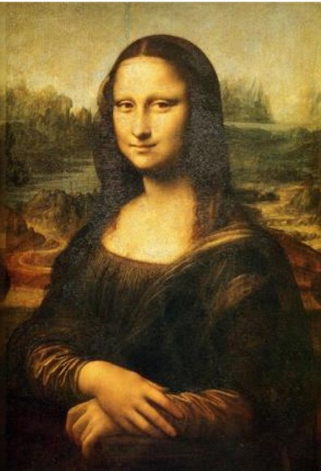
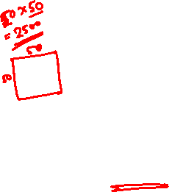
Image Classification - Challenges
Pixelated Images High Dimensional Images
A 50x50 Image requires 2500 input dimensions.
A HD image 1920x1080 is about 2 million inputs. (2 Mega Pixels)
Deep Neural Network

Slide 14
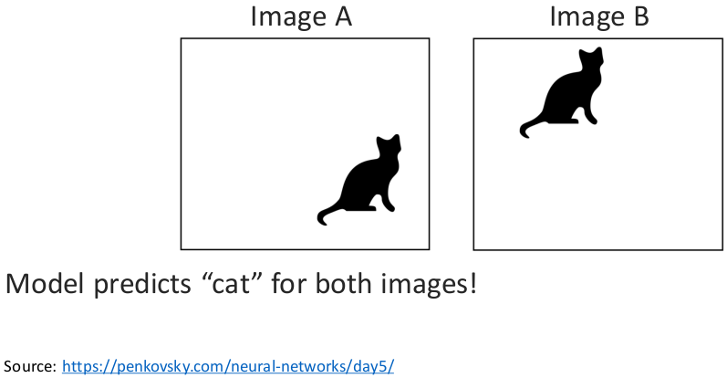
Image Invariance - Challenges
Object can appear anywhere in the image.
Deep Neural Network

Slide 15
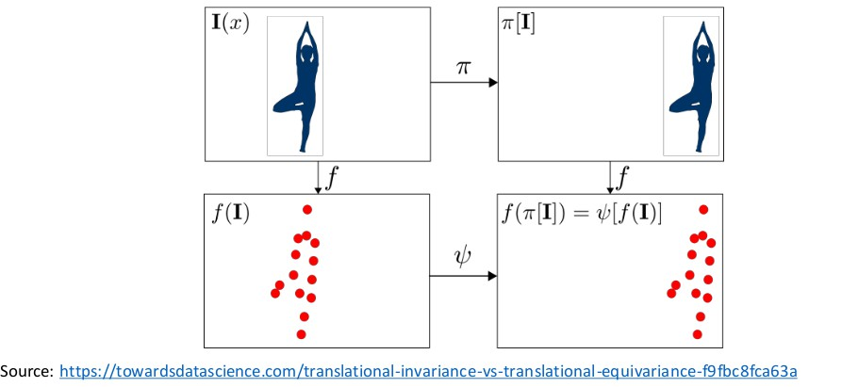
Image Equivariance - Challenges
Changes to the input predictably (equivalently) should not affect the output.
Deep Neural Network

Slide 16
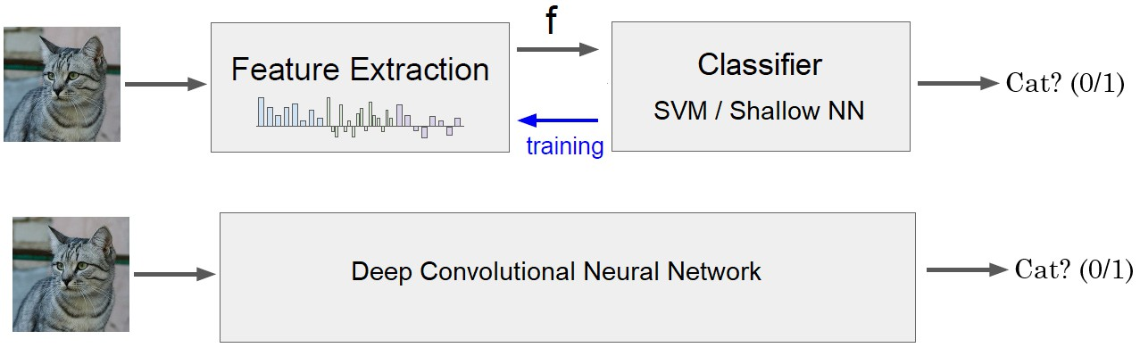
Image Classification - Solution
Deep Neural Network

Slide 17

Table of Contents
Computer Vision Tasks
Image Basics and Image Classification Challenges
Introduction to Convolutional Networks
CNN Components
CNN Architecture Design
Popular CNN Architectures
Transfer Learning
CNN Applications
Implementation Considerations
Summary
1
2
3
4
5
6
7
8
9
10
Deep Neural Network

Slide 18
What is a Convolutional Neural Network?
Definition
A Convolutional Neural Network (CNN) is a specialized type of deep neural network designed to process data with a grid-like topology, such as images, where spatial relationships between data points are important.
Core Insight
CNNs mimic the visual cortex by detecting simple patterns (edges, corners) in early layers and combining them into complex objects (faces, cars) in deeper layers.
Deep Neural Network

Slide 19
Why Convolutional Networks?
Why CNNs for Images?
Translation Invariance: Object recognition regardless of position
Local Patterns: Detect edges, textures, and shapes locally
Hierarchical Features: Low-level → Mid-level → High-level features
Parameter Efficiency: Fewer parameters than fully connected networks Computational Efficiency: Parallel processing of convolutions
Deep Neural Network

Slide 20
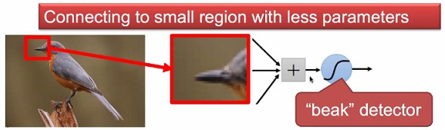
Why CNN for Images - Locality
Some patterns are much smaller than the whole image.
Courtesy: Akka Zemmari
Deep Neural Network

Slide 21
Why CNN for Images - Locality
Some patterns are much smaller than the whole image.
A neuron does not have to see the whole image to discover the pattern.
Courtesy: Akka Zemmari
Deep Neural Network

Slide 22
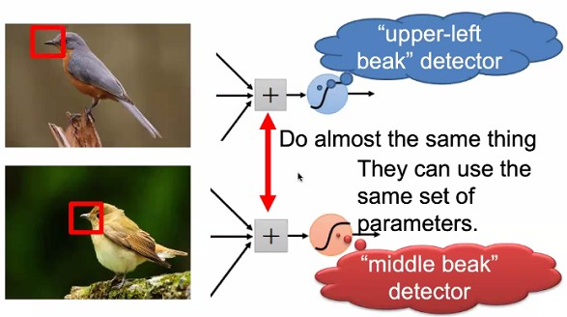
Why CNN for Images - Translation Invariance
Same pattern may appear in different regions.
Courtesy: Akka Zemmari
Deep Neural Network

Slide 23
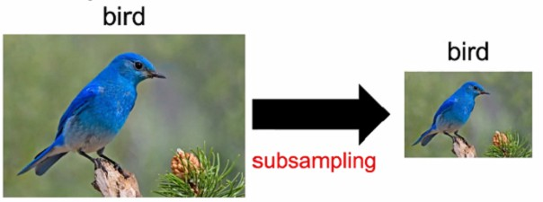
Why CNN for Images - Scale Invariance
Sub-sampling the pixels will not change the object.
We can sub-sample the image to make it smaller.
Less parameters for the network to process the image.
Courtesy: Akka Zemmari
Deep Neural Network

Slide 24
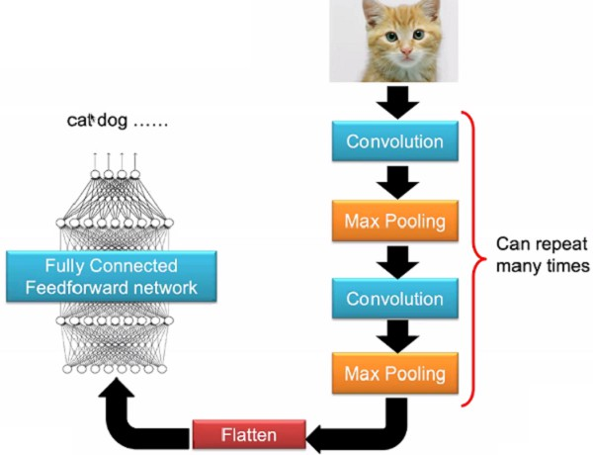
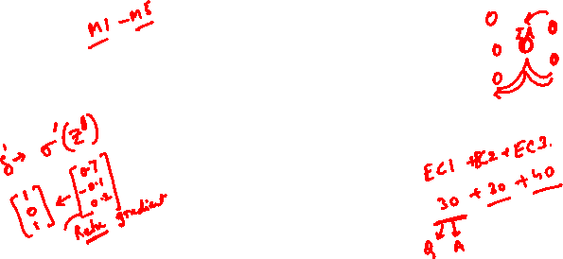
The Whole CNN
Courtesy: Akka Zemmari
Deep Neural Network

Slide 25

References
Zhang, A., Lipton, Z. C., Li, M., & Smola, A. J. (2023). Dive into deep learning. Cambridge University Press. Chapters 6 and 7.
Goodfellow, I., Bengio, Y., Courville, A. (2016). Deep Learning. MIT Press. LeCun, Y., Bottou, L., Bengio, Y., & Haffner, P. (1998). Gradient-based learning applied to document recognition. Proceedings of the IEEE, 86(11), 2278-2324.
Krizhevsky, A., Sutskever, I., & Hinton, G. E. (2012). ImageNet classification with deep convolutional neural networks. Advances in NIPS.
Simonyan, K., & Zisserman, A. (2014). Very deep convolutional networks for large-scale image recognition. arXiv preprint arXiv:1409.1556.
Szegedy, C., et al. (2015). Going deeper with convolutions. Proceedings of the IEEE CVPR.
He, K., Zhang, X., Ren, S., & Sun, J. (2016). Deep residual learning for image recognition. Proceedings of the IEEE CVPR.
Deep Neural Network

